Slide 1

In case the embedded fonts don’t work, here are the download links:
Barlow Condensed
https://fonts.google.com/specimen/Barlow+Condensed
Orbitron
https://fonts.google.com/specimen/Orbitron
@dstoryco
www.dstory.co
THANK YOU FOR
THANKS FOR DOWNLOADING THE TEMPLATE! HOPE IT HELPS YOUR PRESENTATIONS!

Slide 2












MANIA
STRAY KIDS THEMED POWERPOINT TEMPLATE

Slide 3


WHAT IS MANIA
A STATE OF:
OFTEN ACCOMPANIED BY:
Excitement
Overactivity
Psychomotor agitation
Overoptimism
Grandiosity
Impaired judgement
Source: https://www.verywellhealth.com/manic-definition-5188650

Slide 4



THERE ARE 3 MAIN TYPES OF BIPOLAR DISORDER
BIPOLAR 1 DISORDER
BIPOLAR 2 DISORDER
CYCLOTHYMIC DISORDER
Manic episodes last at least 7 days
Less severe episodes of Mania known as Hypomania
Chronic mood instability without extreme mood episodes
Source: https://www.medicalnewstoday.com/articles/bipolar-disorder-facts

Slide 5
MANIA vs HYPOMANIA
 | MANIA | HYPOMANIA
LENGTH OF EPISODE | At least 1 week | At least 4 consecutive days
SEVERITY OF EPISODE | Severe impact on daily life | Not severe enough to affect daily life
PSYCHOTIC SYMPTOMS? | Among the possible symptoms | Not present
Source: https://my.clevelandclinic.org/health/diseases/21603-mania

Slide 6



ALBUM STICKERS
Source: https://twitter.com/skzwifi/status/1512207787341893633?s=20&t=gwRYbWtSDq3wcWk3uVgDnA

Slide 7

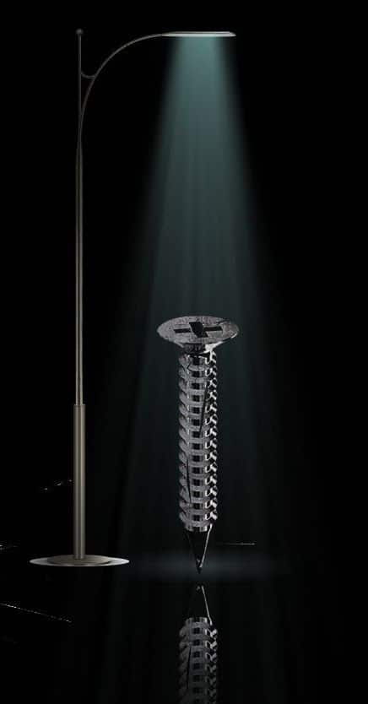
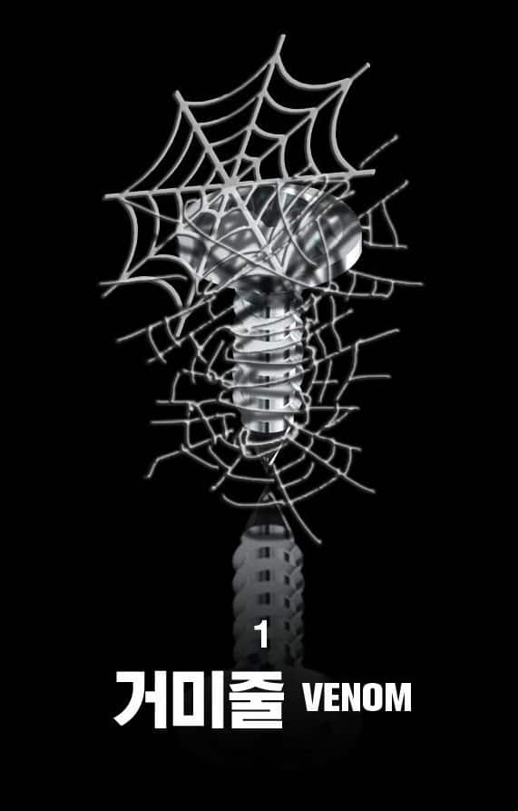


SIGNS OF A MANIC EPISODE
02
RISKY BEHAVIOUR
03
IRRATIBILITY
01
LESS SLEEP
Source: https://my.clevelandclinic.org/health/diseases/21603-mania

Slide 8

SIGNS OF A MANIC EPISODE
01
LESS SLEEP
03
IRRATIBILITY
04
RACING THOUGHTS
02
RISKY BEHAVIOUR
Source: https://my.clevelandclinic.org/health/diseases/21603-mania

Slide 9

SIGNS OF A MANIC EPISODE
01
LESS SLEEP
02
RISKY BEHAVIOUR
04
RACING THOUGHTS
05
RAPID SPEECH
03
IRRATIBILITY
Source: https://my.clevelandclinic.org/health/diseases/21603-mania

Slide 10

SIGNS OF A MANIC EPISODE
02
RISKY BEHAVIOUR
03
IRRATIBILITY
05
RAPID SPEECH
06
HYPERXUALITY
04
RACING THOUGHTS
Source: https://my.clevelandclinic.org/health/diseases/21603-mania

Slide 11

SIGNS OF A MANIC EPISODE
03
IRRATIBILITY
04
RACING THOUGHTS
06
HYPERXUALITY
07
SELF-ESTEEM
05
RAPID SPEECH
Source: https://my.clevelandclinic.org/health/diseases/21603-mania

Slide 12
SIGNS OF A MANIC EPISODE
04
RACING THOUGHTS
05
RAPID SPEECH
07
SELF-ESTEEM
06
HYPERXUALITY
Source: https://my.clevelandclinic.org/health/diseases/21603-mania

Slide 13
SIGNS OF A MANIC EPISODE
05
RAPID SPEECH
06
HYPERXUALITY
07
SELF-ESTEEM
Source: https://my.clevelandclinic.org/health/diseases/21603-mania

Slide 14
LOADING
0%

Slide 15
LOADING
10%

Slide 16
LOADING
20%

Slide 17
LOADING
30%

Slide 18
LOADING
40%

Slide 19
LOADING
50%

Slide 20
LOADING
60%

Slide 21
LOADING
70%

Slide 22
LOADING
80%

Slide 23
LOADING
90%

Slide 24
LOADING
100%

Slide 25
03
IRRATIBILITY
04
RACING THOUGHTS
02
RISKY BEHAVIOUR

Slide 26
02
RISKY BEHAVIOUR
04
RACING THOUGHTS
05
RAPID SPEECH
03
IRRATIBILITY

Slide 27
02
RISKY BEHAVIOUR
03
IRRATIBILITY
05
RAPID SPEECH
04
RACING THOUGHTS

Slide 28
03
IRRATIBILITY
04
RACING THOUGHTS
05
RAPID SPEECH

